Slide 1
CS 110 - Professional Practices in IT Instructor Name : Dr Tariq Umer Email : tariqumer@cuilahore.edu.pk

Slide 2
Week 7 Privacy Risks and Principles

Slide 3
Topics Covered in this Lecture
What is Privacy , Definition and concept
Privacy Threats Categories
New Technology, New Risks

Slide 4
Learning outcomes of this Lecture
To understand the concept of Privacy
Learning Privacy Concept in Islam and daily life.
To know different types of threats for Privacy under new era.
How to manage personal data management keeping Privacy.

Slide 5
What does privacy mean to you?

Slide 6

What is privacy?
There are three key aspects of privacy:
Freedom from intrusion (Entry to another's property without right or permission)
Control of information about oneself
Freedom from surveillance (being tracked, followed, watched, under observation, investigation)
“Being alone.”

Slide 7
Westin “Privacy and Freedom” 1967
“Privacy is the claim of individuals, groups or institutions to determine for themselves when, how, and to what extent information about them is communicated to others”
Privacy is not an absolute
Alan F. Westin, Privacy And Freedom, 25 Wash. & Lee L. Rev. 166 (1968), https://scholarlycommons.law.wlu.edu/wlulr/vol25/iss1/20

Slide 8
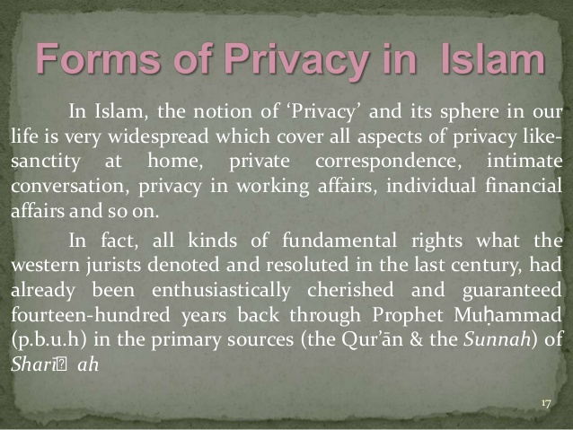

Slide 9
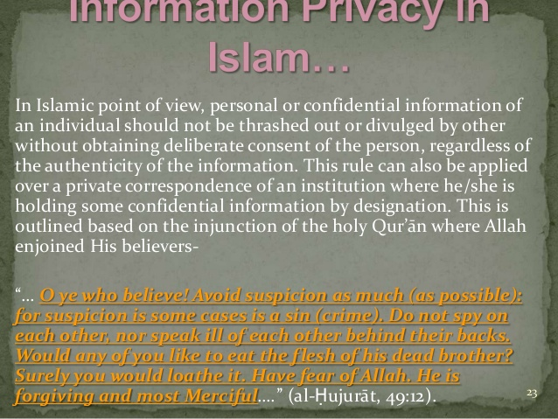

Slide 10
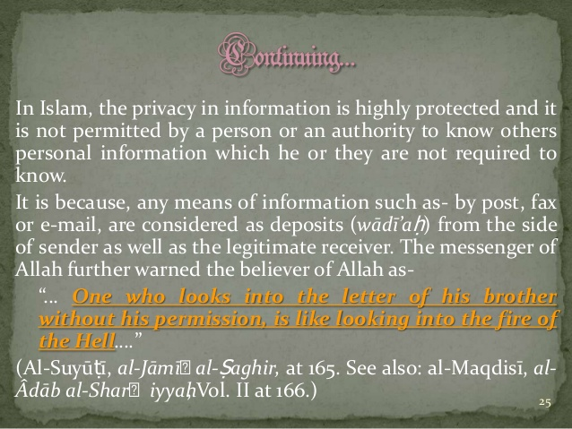

Slide 11
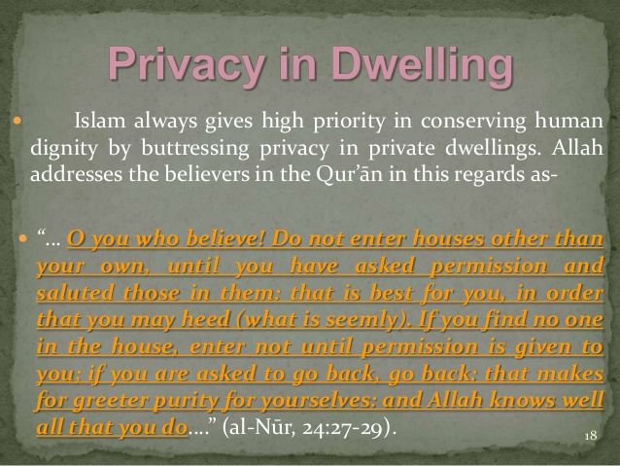

Slide 12
Privacy Threats Categories
Privacy Threats come in several categories:
Intentional/institutional uses of personal information (Primarily for law enforcement and tax collection in the government sector and for marketing and decision making in the private sector by both government and organizations).
Unauthorized use of release by “insiders”, the people who maintain the information
Theft of information
Inadvertent / Unintentional leakage of information through negligence or carelessness
Our own actions (sometimes intentional trade-offs and sometimes when we are unaware of risks)

Slide 13
New Technology, New Risks
Government and private databases (searching data re-identification is easy)
Sophisticated tools for surveillance and data analysis (smart phones send location)
Location data should be Anonymous but it stores phone ID, age and gender info and sent to 3rd parties.
Hidden data in mobile phones
Vulnerability (Susceptible to attack) of data to loss, hacking, and misuse:

Slide 14
New risks
Anything we do in cyberspace is recorded, at least briefly, and linked to our computer or phone, and possibly our name.
With the huge amount of storage space available, companies, organizations, and governments save huge amounts of data that no one would have imagined saving in the recent past.
People often are not aware of the collection of information about them and their activities.
Software is extremely complex. Sometimes businesses, organizations, and website managers do not even know what the software they use collects and stores.
Leaks happen. The existence of the data presents a risk.

Slide 15
New risks
A collection of many small items of information can give a fairly detailed picture of a person’s life.
Direct association with a person’s name is not essential for compromising privacy. Re-identification has become much easier due to the quantity of personal information stored and the power of data search and analysis tools.
If information is on a public website, people other than those for whom it was intended will find it. It is available to everyone. Once information goes on the Internet or into a database, it seems to last forever. People (and automated software) quickly make and distribute copies. It is almost impossible to remove released information from circulation.
It is extremely likely that data collected for one purpose (such as making a phone call or responding to a search query) will find other uses (such as business planning, tracking, marketing, or criminal investigations).

Slide 16
Terminology and principle for managing personal Information
1.Informed consent and Invisible information gathering – collection of personal information about someone without the person’s knowledge (spyware, event data recorders in cars, customer ID number in software of cursor, finger printing)
Example:
A company offered a free program that changed a Web browser’s cursor into a cartoon character. Millions of people installed the program but then later discovered that the program sent to the company a report of the websites its users visited, along with a customer identification number in the software

Slide 17
Terminology and principle for managing personal Information
2. Secondary use – use of personal information for a purpose other than the one it was provided for.
Data mining - searching and analyzing masses of data to find patterns and develop new information or knowledge
Computer matching - combining and comparing information from different databases (using social security number, for example, to match records)
Computer profiling - analyzing data in computer files to determine characteristics of people most likely to engage in certain behavior

Slide 18
Control of Secondary use of personal information (SUPI)
The degree of control one should have over its SUPI.
After informing people what info is collected and what it does with it.
Then give control over SUPI through Informed consent (IS)
Two forms of IS are Opt-in & Opt-out policies
Opt-out by default information will be used.(opt for not use)
Opt-in by default info will not be used.(opt for use)
Data retention (Allow to remain in a place or position or maintain a property or features)

Slide 19
Fair Information Principles or practices for managing personal data
1. Inform people when you collect information about them, what you collect, and how you use it.
2. Collect only the data needed.
3. Offer a way for people to opt out from mailing lists, advertising, and other secondary uses. Offer a way for people to opt out from features and services that expose personal
information.
4. Keep data only as long as needed.

Slide 20
Fair Information Principles or practices for managing personal data
5. Maintain accuracy of data. Where appropriate and reasonable, provide a way for people to access and correct data stored about them.
6. Protect security of data (from theft and from accidental leaks). Provide stronger protection for sensitive data.
7. Develop policies for responding to law enforcement requests for data.

Slide 21
Fair Information Principles or practices for managing personal data
Laws in US, Canada, and Europe using them as ethical practices in many situations but gives custody when court order comes.
There is a wide variation and in interpretation among business and privacy advocates (what info business need and for how long)
Difficult to determine the purpose of supplying info: the increase of cameras used by police or google street view, sent on tweets.
Notes:
If the class doesn't mention it, make sure to mention that online opt-in choices may be pre-checked and require you un-checking the box to avoid opting in.
Be sure to mention the "subject to change without notice" clause found in most privacy policies.

Slide 22
End of Lecture

